Slide 1
Department of Chemical Engineering
UNIT 1
Introduction to Entrepreneurship
Presented by
Dr Vinutha Moses
1/xx

Slide 2
Definition of Entrepreneurship
Entrepreneurship is the process of designing, launching, and running a new business, typically characterized by innovation and risk-taking.
Scope
Economic Growth: Drives new business creation, job opportunities, and economic development.
Innovation: Catalyzes new products, services, and technologies.
Social Impact: Addresses societal needs and can lead to transformative change.
1/xx

Slide 3
Importance of Entrepreneurship in Engineering Innovation
Bridges Technology and Market Needs: Engineers use entrepreneurship to turn innovative ideas into commercially viable products.
Increases Industry Competitiveness: New businesses foster competition, driving continuous improvement.
Accelerates Technological Advancement: Entrepreneurs in engineering push the boundaries of technology and practical application.
Sustainable Solutions: Often focuses on solutions with environmental or social benefits, crucial for sustainable development.
1/xx

Slide 4
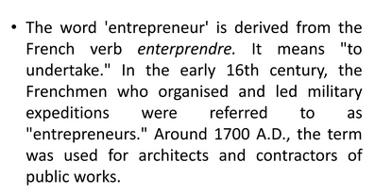
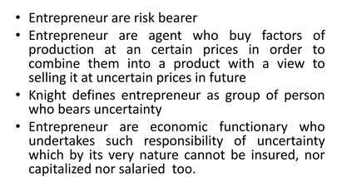
1/xx

Slide 5
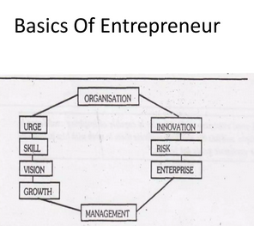
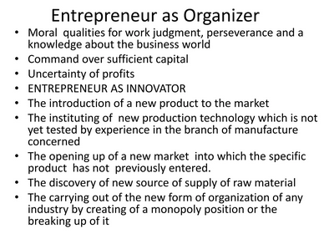

Slide 6
Characteristics and Traits of Successful Entrepreneurs
Innovative Mindset: Ability to think creatively and develop unique solutions.
Risk-Tolerance: Willingness to take calculated risks for potential growth.
Resilience and Persistence: Capability to handle setbacks and pursue goals consistently.
Visionary Leadership: Strong focus on long-term goals and the ability to inspire others.
Flexibility and Adaptability: Ability to pivot or adjust strategies based on market feedback.
Strong Networking Skills: Building valuable connections for resources, guidance, and partnerships.
1/xx

Slide 7
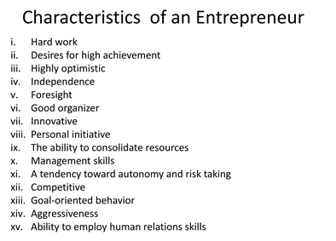

Slide 8
Importance of Entrepreneurship in `Economic Growth
Job Creation: Small and new businesses contribute to a large share of new jobs in the economy.
Wealth Generation: Entrepreneurs increase national wealth and contribute to better standards of living.
Increases Market Dynamism: Entrepreneurship encourages new market entrants, resulting in economic diversification.
Spurs Innovation Ecosystem: Promotes a supportive environment of incubators, investors, and research institutions, enriching the overall economy.

Slide 9
Techniques for Identifying Entrepreneurial Opportunities
Market Research: Identify gaps in the market through surveys, interviews, and trend analysis.
Problem Identification: Recognize common problems in specific areas and brainstorm potential solutions.
Competitor Analysis: Examine competitors’ strengths and weaknesses to identify unmet customer needs.
Innovation Thinking: Use techniques like design thinking to identify new ways of addressing existing problems.
Networking and Observation: Engaging with potential customers and industry experts to uncover new ideas.
1/xx

Slide 10
Types of Entrepreneurs
Innovative Entrepreneurs: Focus on creating new products, technologies, or services.
Example: Inventors and developers of novel technology startups.
Imitative Entrepreneurs: Replicate successful business models in new markets or niches.
Example: Local franchises or adaptations of successful international models.
Fabian Entrepreneurs: Slow adopters of innovation; they typically wait until a product or service has been proven.
Example: Conservative business owners who follow trends after they are well-established.
Drone Entrepreneurs: Resistant to change and avoid new technologies and strategies, often resulting in stagnation.
Example: Traditional businesses that rely solely on legacy methods.

Slide 11
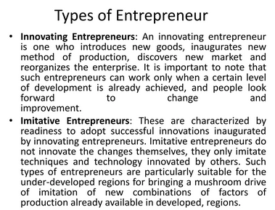
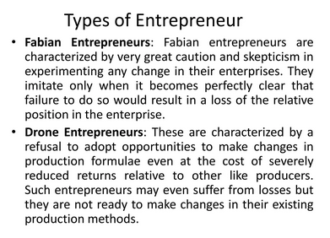

Slide 12
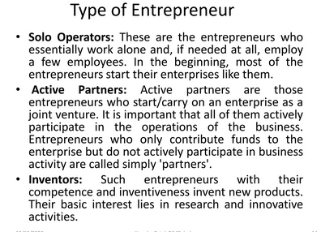
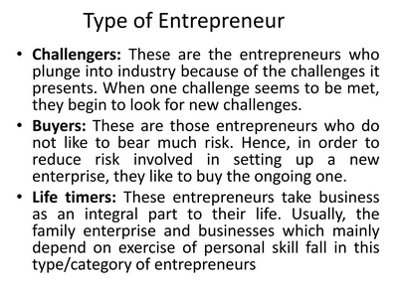

Slide 13
Innovative Entrepreneurs examples
Elon Musk (SpaceX, Tesla): Musk created groundbreaking innovations in the fields of electric vehicles, space exploration, and renewable energy.
Steve Jobs (Apple): Jobs introduced products like the iPhone, which transformed the tech and mobile industry.
Sara Blakely (Spanx): Blakely invented a new type of shapewear and redefined the hosiery industry with innovative products.
1/xx

Slide 14
2. Imitative Entrepreneurs examples
Howard Schultz (Starbucks): Schultz brought the Italian espresso bar concept to the U.S. with Starbucks, creating a global coffee culture.
Sam Walton (Walmart): Walton replicated discount retailing concepts and tailored them to rural markets, creating the world’s largest retailer.
Ray Kroc (McDonald’s): Kroc took the original McDonald's restaurant and expanded it into a global fast-food franchise by replicating its business model.
1/xx

Slide 15
3. Fabian Entrepreneurs examples
Kodak: For years, Kodak was slow to embrace digital photography, relying on its film business despite industry shifts.
Blackberry: Known for its secure mobile devices, Blackberry was hesitant to adopt touchscreen technology and lost market share to iPhone and Android.
Barnes & Noble: The bookseller was cautious in adapting to the rise of e-books and digital media, which slowed its growth compared to competitors like Amazon.
4. Drone Entrepreneurs examples
Blockbuster: Blockbuster continued its brick-and-mortar model even as streaming became popular, ultimately leading to its decline as Netflix rose.
Sears: Reluctant to change its traditional retail model, Sears didn’t adapt quickly to online retail, which contributed to its financial struggles.
Taxi Companies (pre-Uber): Many taxi companies ignored ride-sharing technology, resulting in loss of business to companies like Uber and Lyft.
1/xx

Slide 16
Introduction to Economic Development and Entrepreneurship
Economic Development
Economic development refers to the process by which a nation improves the economic, political, and social well-being of its people.
Key indicators include GDP growth, improved living standards, reduced poverty, and job creation.

Slide 17
Role of Entrepreneurship in Economic Development
Job Creation: Entrepreneurs start businesses that generate new employment opportunities
Innovation: Entrepreneurs introduce new products, services, and technologies, driving innovation and efficiency in the economy.
Wealth Generation: Through successful ventures, entrepreneurs contribute to national wealth, enhancing economic stability.
Economic Diversity: Entrepreneurship encourages diversification, reducing reliance on a single industry and fostering resilience in the economy.
1/xx

Slide 18
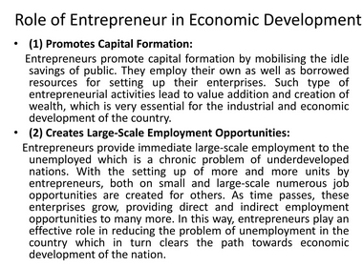
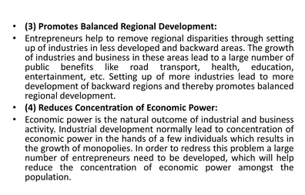

Slide 19
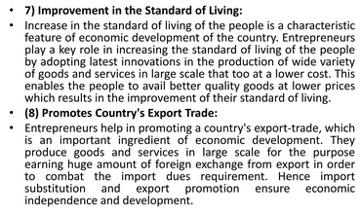
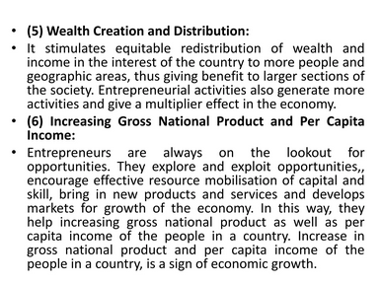

Slide 20
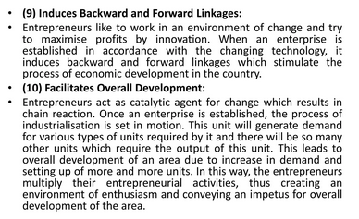

Slide 21
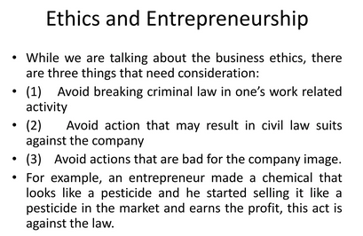

Slide 22
Emerging Trends in Entrepreneurship
1. Digital Entrepreneurship
The rise of online businesses, e-commerce, and digital platforms has transformed traditional business models.
Entrepreneurs leverage digital tools for everything from marketing to customer service, scaling businesses faster and reaching global markets.
2. Social Entrepreneurship
Social entrepreneurs focus on addressing social and environmental issues, blending profit with purpose.
This trend emphasizes sustainable impact, where businesses aim to create social value alongside financial success.
1/xx

Slide 23
3. Green Startups and Sustainability
As environmental awareness grows, green startups are developing eco-friendly products and sustainable practices.
Entrepreneurs in this space focus on reducing waste, using renewable resources, and adopting climate-conscious business models.
4. The Gig Economy
The gig economy has reshaped the labor market, allowing individuals to work freelance or on short-term contracts.
This shift enables entrepreneurs to build flexible, cost-effective teams and tap into specialized talent on-demand.
5. Remote Work and Virtual Collaboration
Remote work has become a norm, especially post-pandemic, enabling entrepreneurs to reduce overhead costs and hire talent from around the world.
Virtual collaboration tools support efficient team management and communication, making distributed teams viable for startups.
1/xx

Slide 24
6. Tech-Driven Business Innovations
Technologies like artificial intelligence, blockchain, and IoT are creating new entrepreneurial opportunities.
Tech-driven innovations enable entrepreneurs to create more efficient, data-driven, and customized products, enhancing customer experiences and market competitiveness.
Together, these trends reflect the evolving nature of entrepreneurship, where technology, social impact, and flexibility are reshaping how businesses are started and scale
1/xx

Slide 25
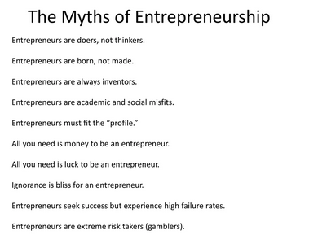

Slide 26
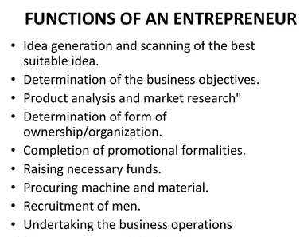

Slide 27
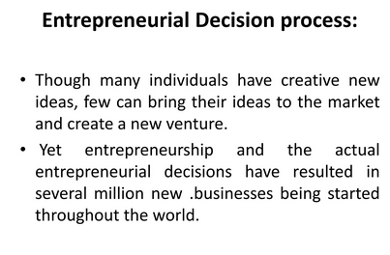
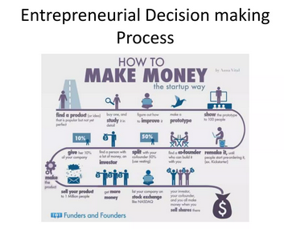

Slide 28
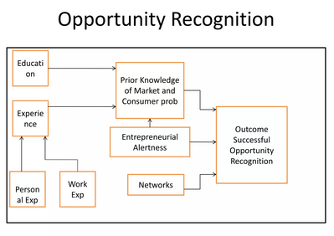

Slide 29
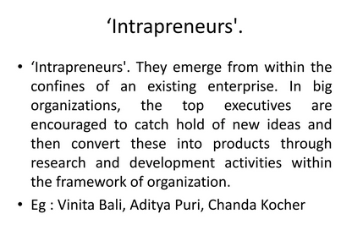
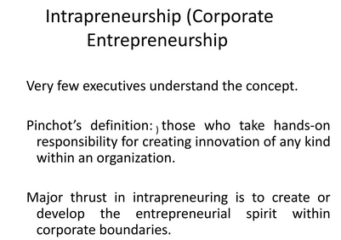

Slide 30
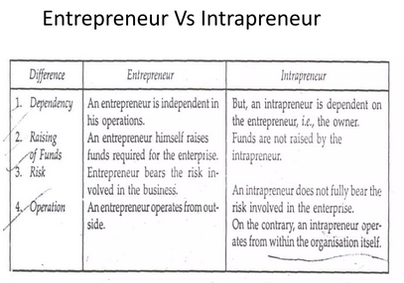

Slide 31
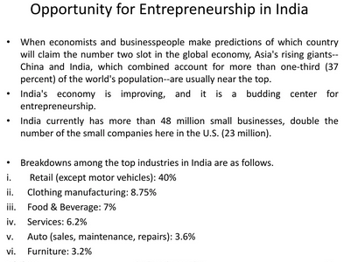

Slide 32
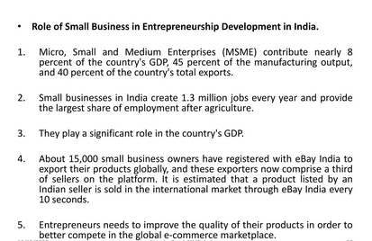
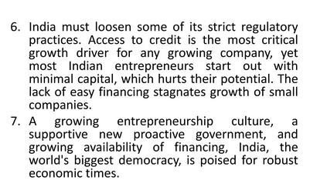

Slide 33
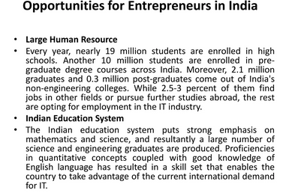
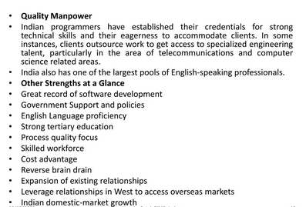

Slide 34
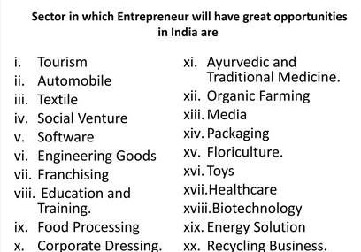

Slide 35
